Slide 1

无人机航拍场景下的语义三维重建
陈煜1701213988@pku.edu.cn
王尧 wangyao@pku.edu.cn
王旭普 wangyao@pku.edu.cn

Slide 2
CONTENTS
Introduction
Related Work
Our Work
Experiments
References
PART ONE
PART TWO
PART THREE
PART FOUR
PART SIX

Slide 3
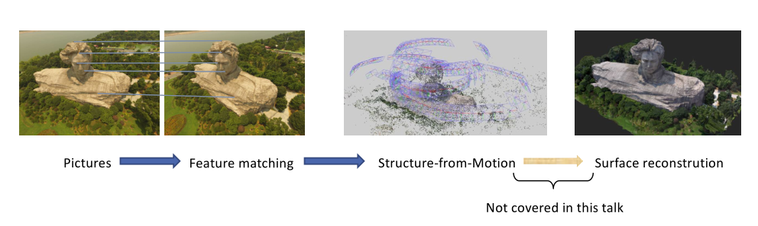
Structure from Motion

Slide 4
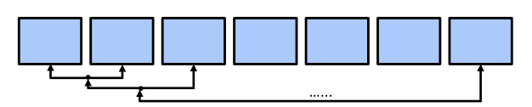
Incremental SfM
Adding one camera every time, and perform BA after registration

Slide 5
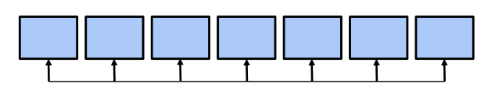
Global SfM
Rotation averaging and translation averaging for all cameras

Slide 6
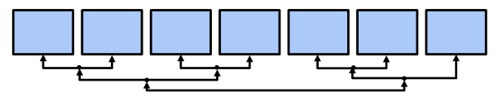
Hierarchical SfM
A bottom-up manner, started from two-view reconstruction and merged by similarity transformation

Slide 7
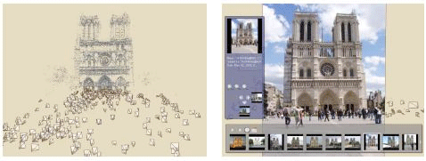
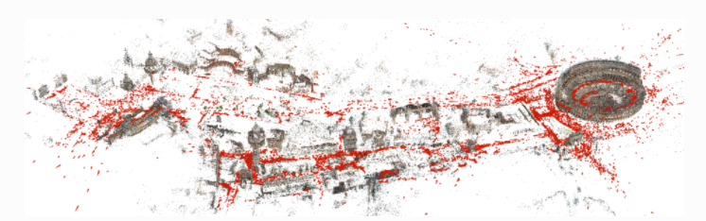
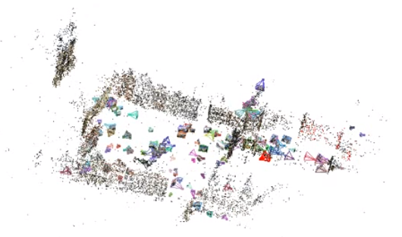
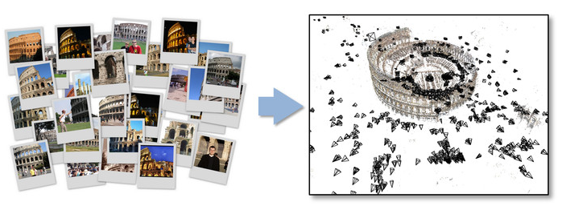
Incremental Approaches
Colmap [3]
Photo Tourism [1]
VisualSFM [4]
Bundler [2]
[1] Noah Snavely, Steven M. Seitz, Richard Szeliski. Photo Tourism: Exploring image collections in 3D. ACM Transactions on Graphics (Proceedings of SIGGRAPH 2006), 2006.
[2] Snavely K N. Scene reconstruction and visualization from internet photo collections[M]. University of Washington, 2008.
[3] Schönberger J L, Frahm J M. Structure-from-Motion Revisited[C]// Computer Vision and Pattern Recognition. IEEE, 2016.
[4] Wu C. Towards Linear-Time Incremental Structure from Motion[C]// International Conference on 3dtv-Conference. IEEE, 2013:127-134.

Slide 8
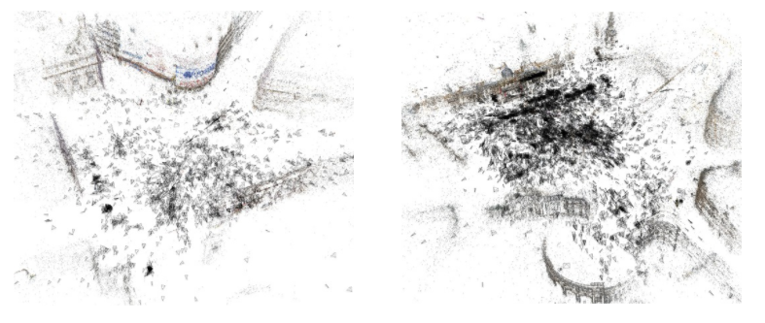
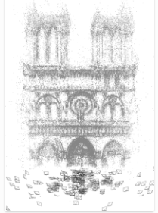
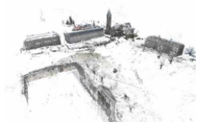
Global Approaches
1DSfM [1]
[3, 4]
[1] Wilson K, Snavely N. Robust Global Translations with 1DSfM[C]// European Conference on Computer Vision. Springer, Cham, 2014:61-75.
[2] Crandall D, Owens A, Snavely N, et al. Discrete-continuous optimization for large-scale structure from motion[C]// Computer Vision and Pattern Recognition. IEEE, 2011:3001-3008.
[3] Avishek Chatterjee, Venu Madhav Govindu, Efficient and Robust Large-Scale Rotation Averaging. proceedings of International Conference on Computer Vision (ICCV) 2013
[4] Avishek Chatterjee, Venu Madhav Govindu. Robust Relative Rotation Averaging. IEEE Transactions on Pattern Analysis and Machine Intelligence, volume PP, 2017
DISCO [2]

Slide 9
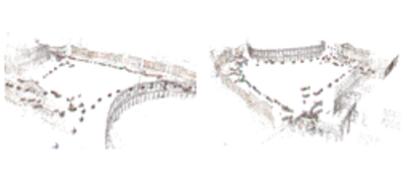
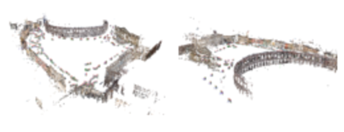
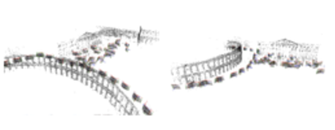
Hierarchical Approaches
SAMANTHA [1, 2, 3]
[1] Farenzena M, Fusiello A, Gherardi R. Structure-and-motion pipeline on a hierarchical cluster tree[C]// IEEE, International Conference on Computer Vision Workshops. IEEE, 2009:1489-1496.
[2] Gherardi R, Farenzena M, Fusiello A. Improving the efficiency of hierarchical structure-and-motion[C]// Computer Vision and Pattern Recognition. IEEE, 2010:1594-1600.
[3] Toldo R, Gherardi R, Farenzena M, et al. Hierarchical structure-and-motion recovery from uncalibrated images[J]. Computer Vision & Image Understanding, 2015, 140(C):127-143.

Slide 10
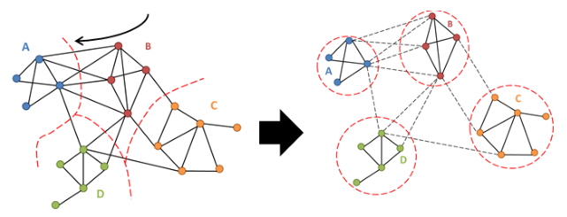
Divide and Conquer
[1] Sweeney C, Fragoso V, Hollerer T, et al. Large Scale SfM with the Distributed Camera Model[J]. 2016:230-238.
[2] Bhowmick B, Patra S, Chatterjee A, et al. Divide and Conquer: Efficient Large-Scale Structure from Motion Using Graph Partitioning[C]// Asian Conference on Computer Vision. 2015:273-287.

Slide 11
Three SfM Paradigms
Incremental
Global
Hierarchical
Feature extracting and matching
√
√
√
Match Graph Initialization
Initialized by carefully
selected two-view
All views are treated
equally
Atomic models
Perspective-n-Point
(PnP), 2D-3D
correspondences
Rotation and translation
averaging
Camera Registration
3D-3D fusion
Bundle Adjustment
Iterative, many times
BA when merging
one time
Advantages
Robust
Fewer BA steps
Evenly-distributed errors
Disadvantages
Prune to drifting
errors
Model merging, graph
partition
Prune to noisy pairwise
matches
Software
Bundler, openMVG,
VisualSfM, Theia
Research papers
openMVG, Theia

Slide 12
Two Main Bottlenecks
60%
30%
Feature Matching
Bundle Adjustment

Slide 13
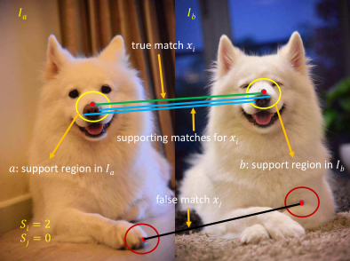
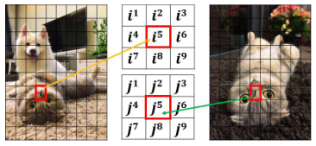
Grid-based Motion Statistics
[1] JW Bian, WY Lin, Y Matsushita, SK Yeung, TD Nguyen, MM Cheng. Gms: Grid-based motion statistics for fast, ultra-robust feature correspondence. IEEE Conference on Computer Vision and Pattern Recognition (CVPR), 2017. 4.

Slide 14
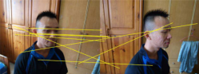
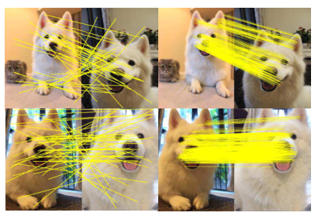
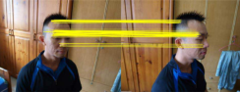
Grid-based Motion Statistics
SIFT + RANSAC
SIFT
GMS
GMS without RANSAC

Slide 15
GMS + RANSAC
Combination of GMS and RANSAC
GMS is not sufficient for geometric verification
Improve both efficiency and accuracy

Slide 16
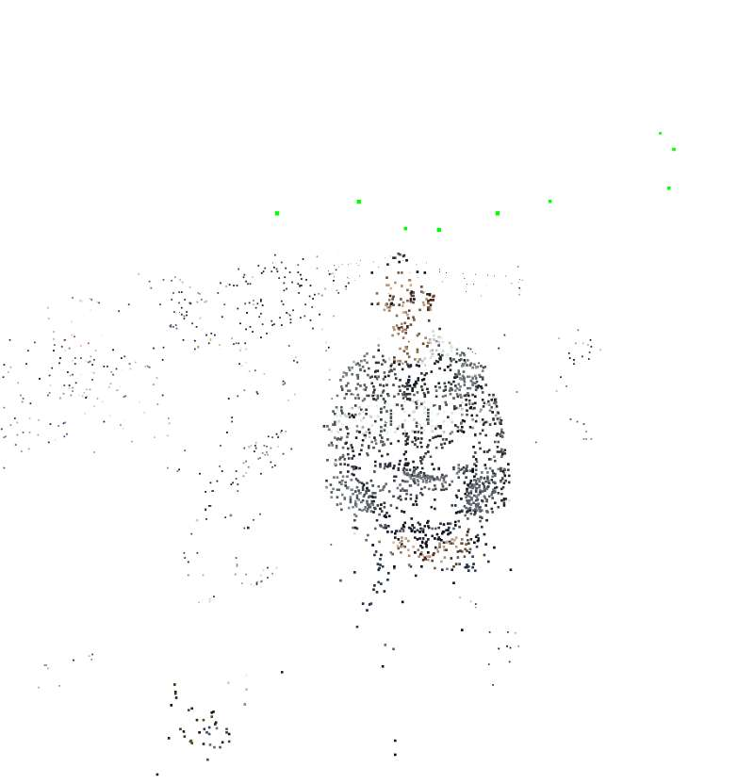
GMS + RANSAC
BF
RANSAC
GMS
GMS + RANSAC
Data
Number
Number
Time (s)
Number
Number
Time (s)
cathedral
9586
2787
0.133
3889
2936
0.010
Ajay
8440
2679
0.125
4065
2555
0.015
David
8683
1603
0.128
2132
1733
0.008
elephant
9899
3626
0.132
4180
3315
0.009
5
60
60
60
60
60
60
ORB is used as feature detector in here
Demo can be downloaded from my Github page: https://github.com/AIBluefisher/SfM/tree/master/src/feature

Slide 17
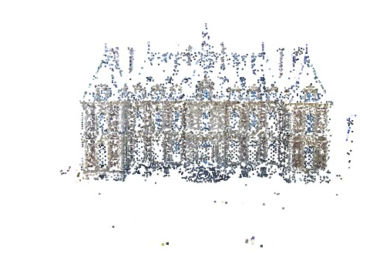
GMS + RANSAC
BF
RANSAC
GMS
GMS + RANSAC
Data
Number
Number
Time (s)
Number
Number
Time (s)
cathedral
2359
347
0.038
410
350
0.004
Ajay
487
70
0.016
9
7
0.006
David
966
101
0.022
78
74
0.003
elephant
1494
615
0.028
446
421
0.003
5
60
60
60
60
60
60
SIFT is used as feature detector in here
Demo can be downloaded from my Github page: https://github.com/AIBluefisher/SfM/tree/master/src/feature

Slide 18
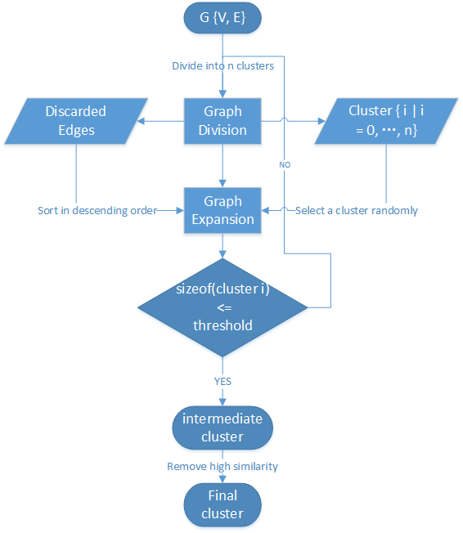
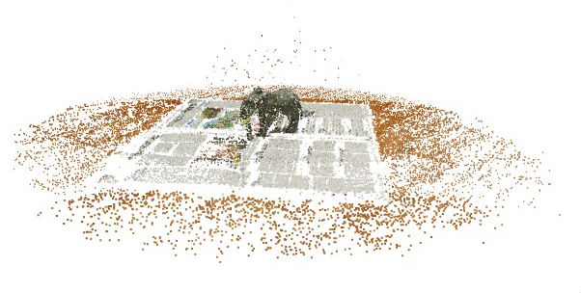
Algorithm of Camera Cluster

Slide 19
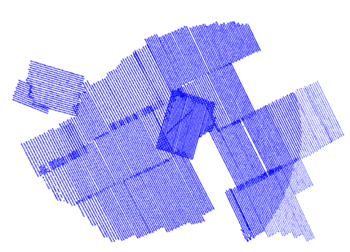
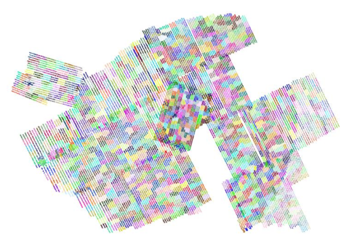
Camera Cluster
Camera Poses
Camera Clustering Result

Slide 20
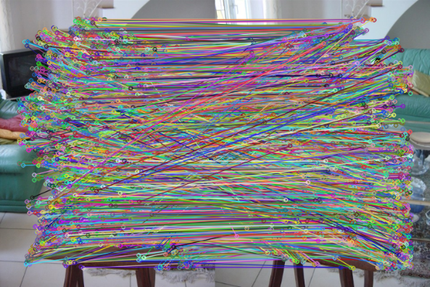
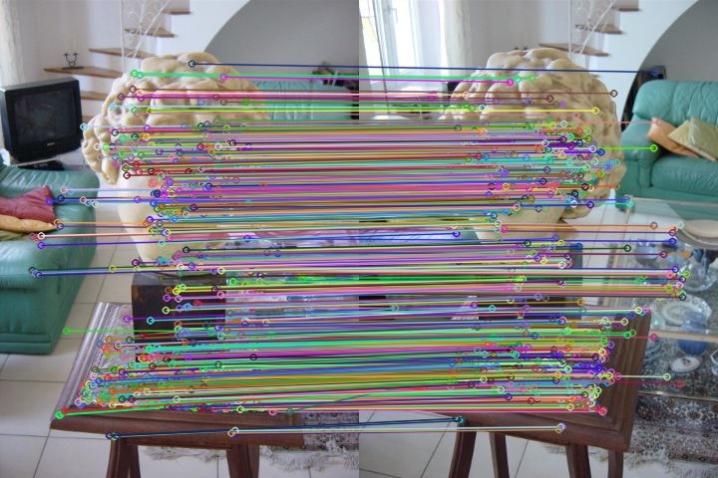
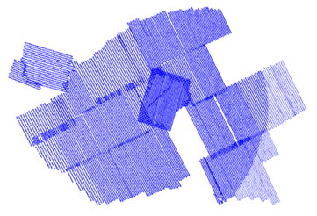
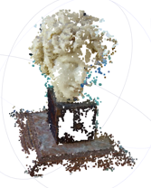
Pipeline for Reconstruction
Pictures
Feature Matching
Geometric Verifying
Camera Clustering
Local Incremental SfM
Structure Merging

Slide 21
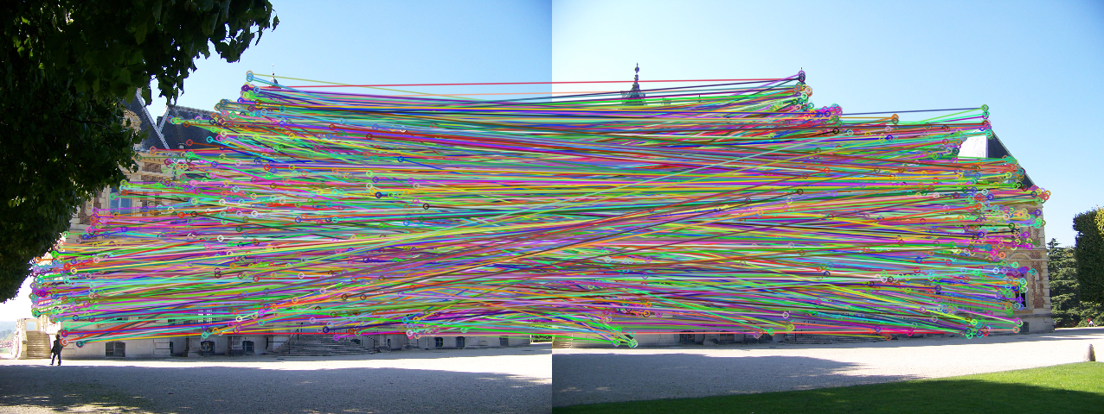
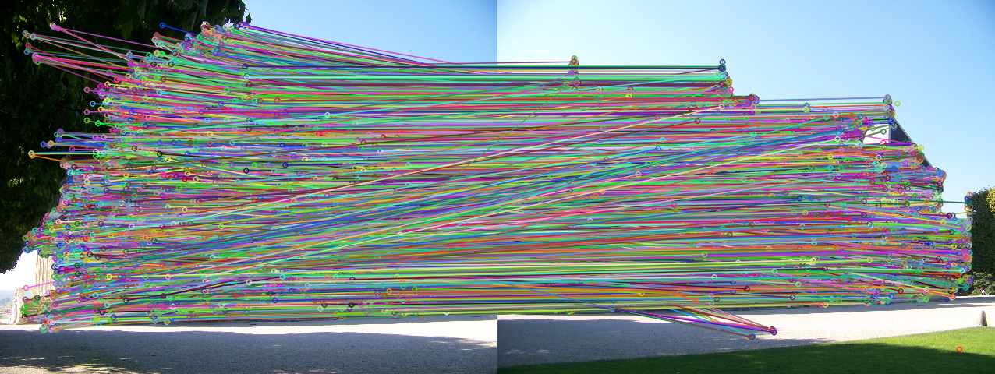
GMS + RANSAC
GMS + RANSAC with ORB
RANSAC with ORB
More features, more support and better result

Slide 22
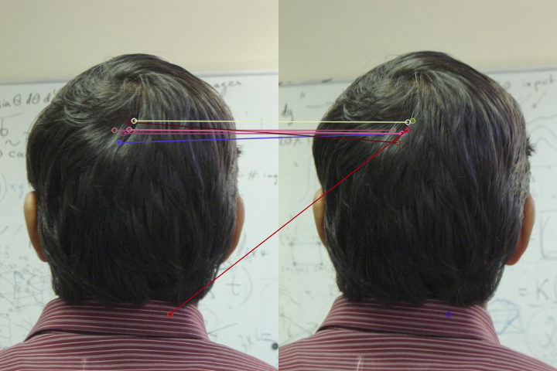
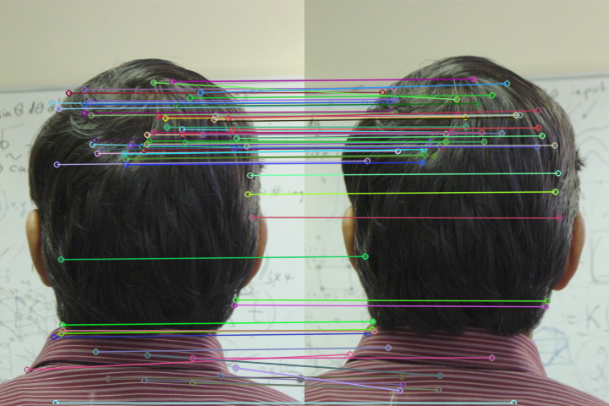
GMS + RANSAC
GMS + RANSAC with SIFT
RANSAC with SIFT
little features, may fail in reconstruction

Slide 23
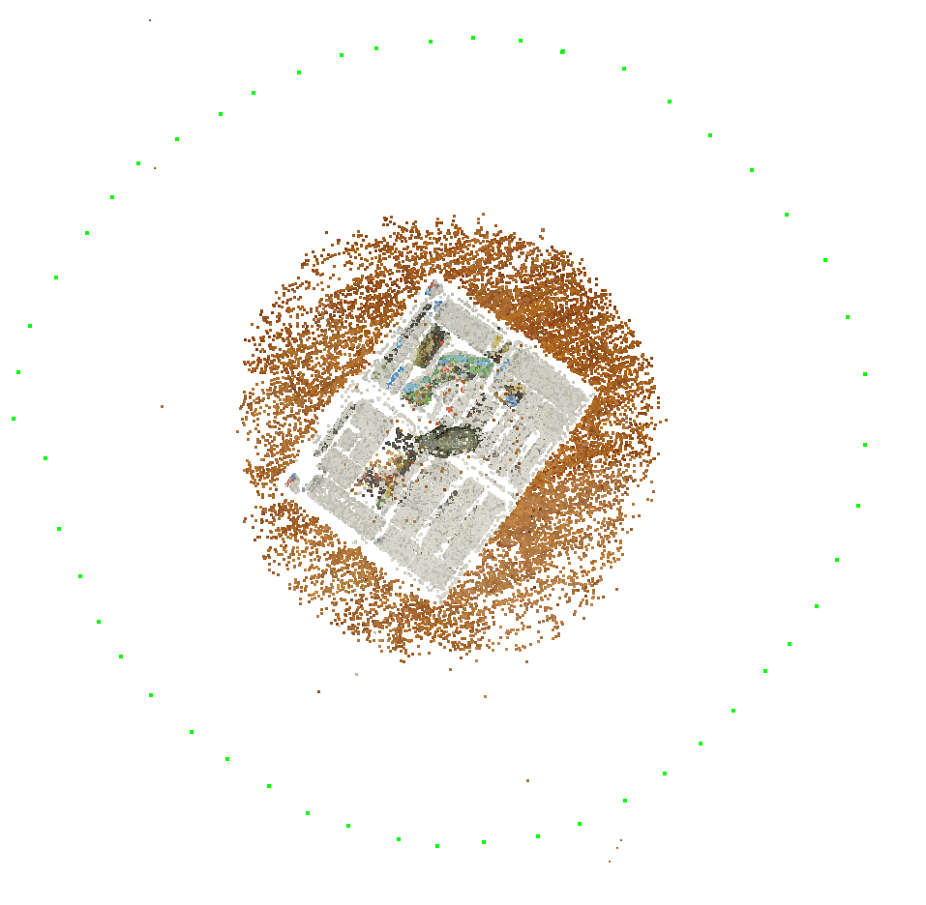
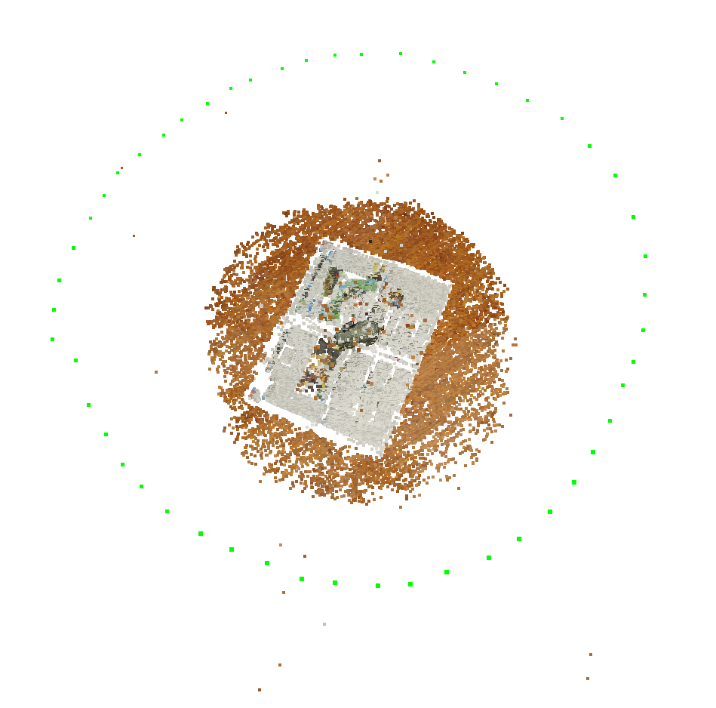
Reconstruction Results
20%
30%
ACRANSAC
GMS + ACRANSAC

Slide 24
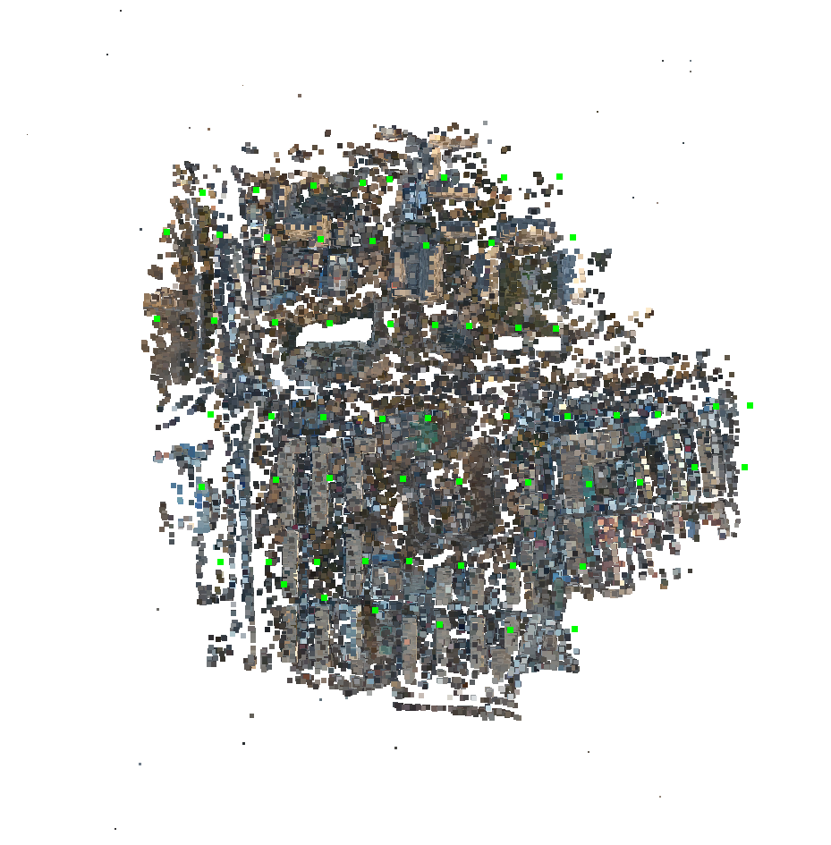
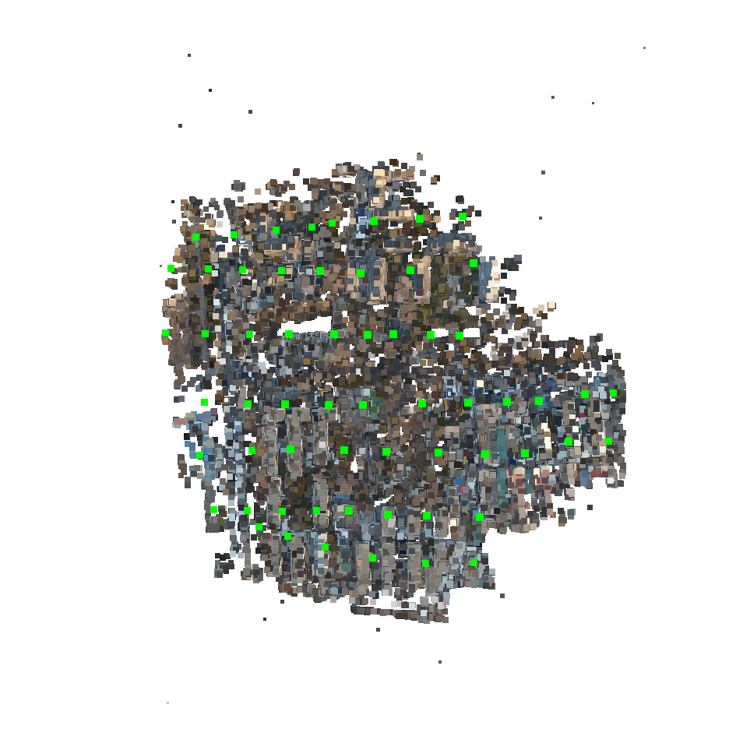
Reconstruction Results
ACRANSAC
GMS + ACRANSAC

Slide 25
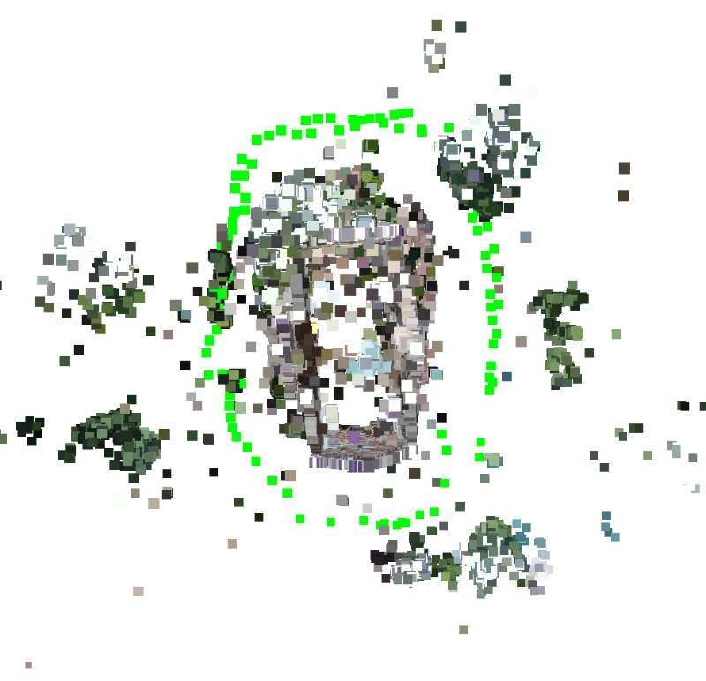
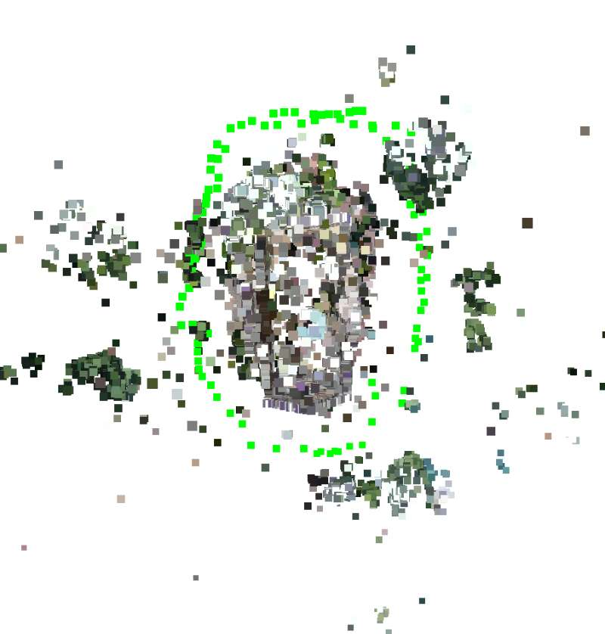
Reconstruction Results
ACRANSAC
GMS + RANSAC

Slide 26
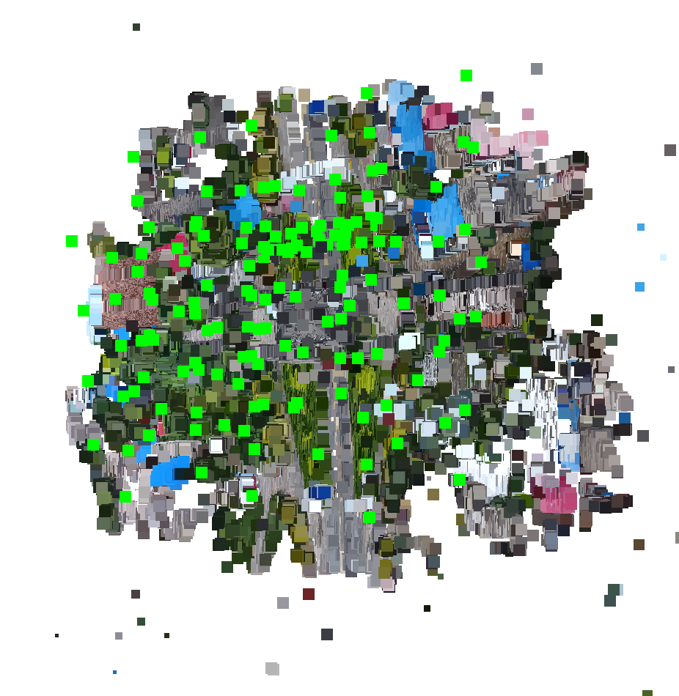
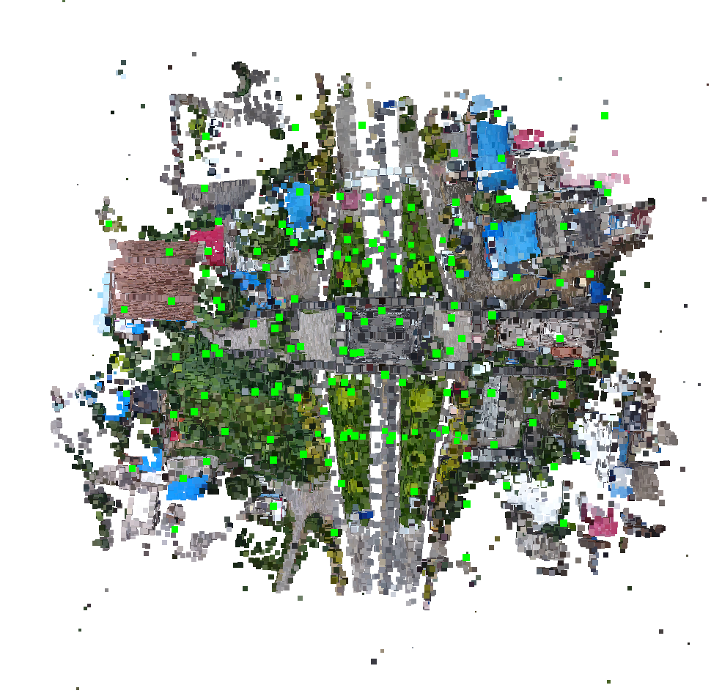
Reconstruction Results
ACRANSAC
GMS + RANSAC

Slide 27
Reconstruction Results
ACRANSAC
GMS + ACRANSAC
Dataset
Views
Poses
Points
Residuals
RMSE
Time
Views
Poses
Points
Residuals
RMSE
Time
elephant
52
52
55467
388096
0.421443
25.47
52
52
60773
274027
0.376776
25.168
high6
60
60
73478
272143
0.524914
33.792
60
60
74817
178258
0.490911
49.329
building
97
97
160056
789944
0.318991
148.298
97
97
163206
689435
0.304753
106.443
anyuanmen
148
148
279225
1551089
0.547591
245.594
148
148
283536
1330565
0.529377
224.622
cangzhou
400
399
110777
1013698
0.555473
1060.44
400
400
151850
820894
0.526021
1249.38
campus
1040
1040
157702
898443
0.555138
5965.39
1040
1030
180230
611284
0.526021
10215.1

Slide 28
Statistics of Camera Cluster
Dataset | Views | Size | Cluster | Cameras | Edges | Time
anyuanmen | 148 | 60 | 6 | 250 | 1593/2702 | 22m 03s
 |  | 80 | 6 | 305 | 2592/2609 | 26m 53s
 |  | 100 | 5 | 308 | 2632/3234 | 28m 08s
 |  | 120 | 2 | 204 | 2689/2689 | 21m 41s
 |  | 148 | 1 | 148 | -/- | 25m 41s
cangzhou | 400 | 60 | 92 | 4005 | 8988/9052 | 28m 23s
 |  | 80 | 13 | 702 | 4447/9263 | 11m 56s
 |  | 100 | 34 | 2497 | 8986/9110 | 23m 58s
 |  | 120 | 25 | 2183 | 9205/9302 | 26m 37s
 |  | 400 | 1 | 400 | -/- | 18m 56s
campus | 1040 | 60 | 169 | 6906 | 28857/29024 | 51m 56s
 |  | 80 | 75 | 4135 | 26887/29057 | 45m 42s
 |  | 100 | 45 | 3084 | 28480/29053 | 44m 23s
 |  | 120 | 31 | 2598 | 28803/29085 | 41m 41s
 |  | 1040 | 1 | 1040 | -/- | 3h 51m 45s

Slide 29
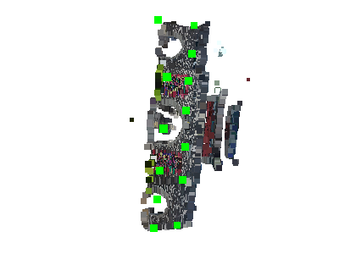
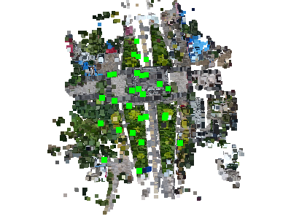
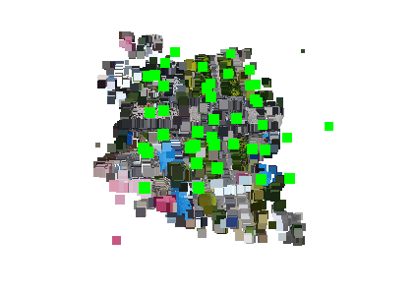
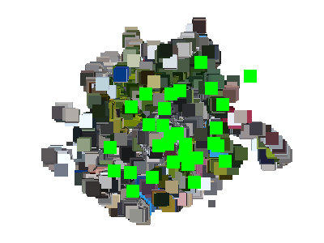
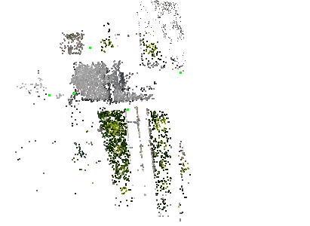
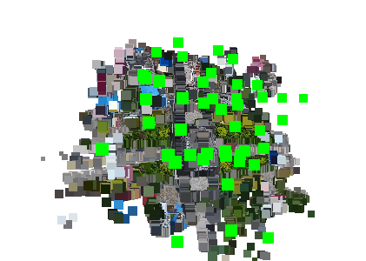
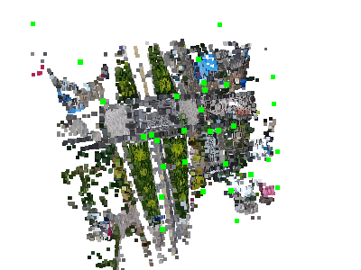
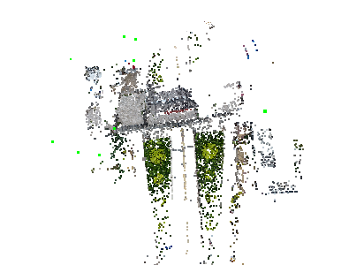







Partial Reconstruction

Slide 30















Partial Reconstruction

Slide 31
Conclusion
Improve accuracy by GMS + xRANAC
Divide to “conquer” bottlenecks

Slide 32
Future Work
“Conquer” partial reconstructions into one

Slide 33
Future Work
Pictures
Feature Matching
Geometric Verifying
Camera Clustering
Computer 0
Cluster 0
Computer 1
Cluster 1
Local SfM ?
……
……
Final 3D Model
Computer n
Cluster n
Global SfM ?

Slide 34
References
[1] Noah Snavely, Steven M. Seitz, Richard Szeliski. Photo Tourism: Exploring image collections in 3D. ACM Transactions on Graphics (Proceedings of SIGGRAPH 2006), 2006.
[2] Snavely K N. Scene reconstruction and visualization from internet photo collections[M]. University of Washington, 2008.
[3] Schönberger J L, Frahm J M. Structure-from-Motion Revisited[C]// Computer Vision and Pattern Recognition. IEEE, 2016.
[4] Wu C. Towards Linear-Time Incremental Structure from Motion[C]// International Conference on 3dtv-Conference. IEEE, 2013:127-134.
[5] Wilson K, Snavely N. Robust Global Translations with 1DSfM[C]// European Conference on Computer Vision. Springer, Cham, 2014:61-75.
[6] Crandall D, Owens A, Snavely N, et al. Discrete-continuous optimization for large-scale structure from motion[C]// Computer Vision and Pattern Recognition. IEEE, 2011:3001-3008.
[7] Farenzena M, Fusiello A, Gherardi R. Structure-and-motion pipeline on a hierarchical cluster tree[C]// IEEE, International Conference on Computer Vision Workshops. IEEE, 2009:1489-1496.
[8] Gherardi R, Farenzena M, Fusiello A. Improving the efficiency of hierarchical structure-and-motion[C]// Computer Vision and Pattern Recognition. IEEE, 2010:1594-1600.
[9] Toldo R, Gherardi R, Farenzena M, et al. Hierarchical structure-and-motion recovery from uncalibrated images[J]. Computer Vision & Image Understanding, 2015, 140(C):127-143.
[10] JW Bian, WY Lin, Y Matsushita, SK Yeung, TD Nguyen, MM Cheng. Gms: Grid-based motion statistics for fast, ultra-robust feature correspondence. IEEE Conference on Computer Vision and Pattern Recognition (CVPR), 2017. 4.
[11] Lowe D G, Lowe D G. Distinctive Image Features from Scale-Invariant Keypoints[J]. International Journal of Computer Vision, 2004, 60(2):91-110.
[12] Rublee E, Rabaud V, Konolige K, et al. ORB: An efficient alternative to SIFT or SURF[C]// IEEE International Conference on Computer Vision. IEEE, 2012:2564-2571.
Notes:
模板来自于 http://www.ypppt.com

Slide 35
THANKS FOR LISTENING

